Slide 1
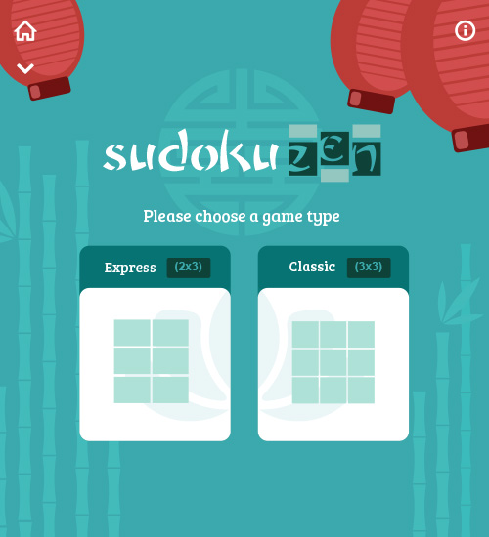
Sudoku Zen
Interaction Specification
Home screen animation order
Backgroud [fades in], bamboo [slide in from bottom]
[audio: asian lotus]
Lanterns [slide in from top] and pivot from left to right a bit. Slight breeze.
[audio: short_whoosh(1-3)]
Symbol behind logo [fade in]
Sudoku Zen logo [fades in]
Arcade game selection area with shapes [fade in]

Slide 2
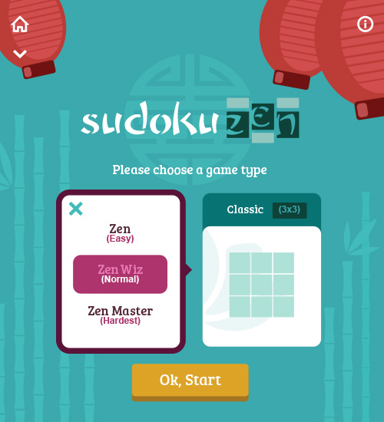
Sudoku Zen
Interaction Specification
Home screen difficulty selection
Interaction:
User clicks “express” or “classic” game mode
[audio: click3]
[audio: pop_drip]
Result:
-difficulty area [fades in] from left or right
[audio: short_whoosh(1-3)]
Interaction:
User clicks difficulty mode
Result:
-area highlights and “ok start” button [fades in]
Interaction:
User clicks ‘ok start’
Result:
-overlay color over board
[audio: short_whoosh(1-3)]
[audio: asian_magic_notification]

Slide 3
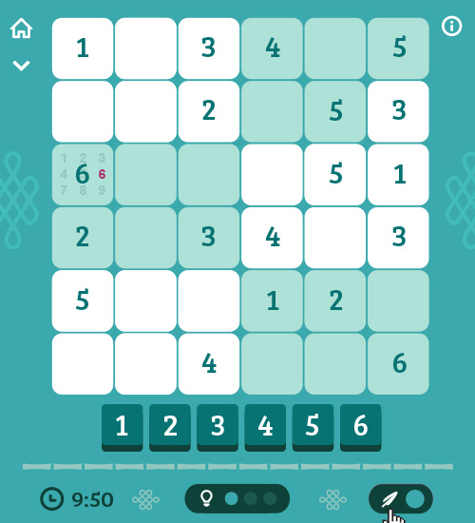
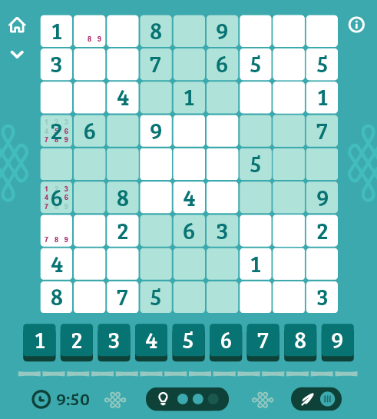
Sudoku Zen
Interaction Specification
Board animation
(2x3) (3x3)
Entire board [fades in] [audio: short_whoosh(1-3)]
Numbers on board [pop in] from left to right. [audio: pop_drip]
Control numbers [fade in and slide up] [audio: short_whoosh(1-3)]
Line seperator [fade in and slide up]
Timer area [fade in and slide up]

Slide 4
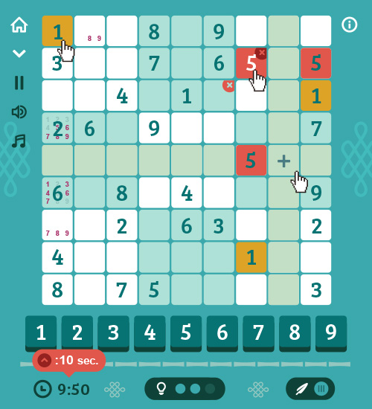
Sudoku Zen
Interaction Specification
Cell Interactions
Interaction:
User clicks a number on the board
[audio: click3]
Result:
-Board highlights all places that number is located (gold bg)
[fades in]
Interaction:
User hovers over the board to place a number
Result:
-board highlights horizontal and vertical cells with a plus icon over place to add number
Interaction:
User places a number that isn’t valid or incorrect (red bg with white number)
[audio: misc_menu_3]
Result:
-board highlights the cell red. Red shows until user changes it or removes the number.
-hovering over the incorrect number shows the red x to remove
Interaction:
User clicks the down chevron menu
[audio: short_whoosh(1-3)]
Result:
-Pause button, sound fx icon and music icon slide down.
Interaction:
User clicks Hint
[audio: asian magic notification]
Result:
-board highlights hint number in gold and [fades out]

Slide 5
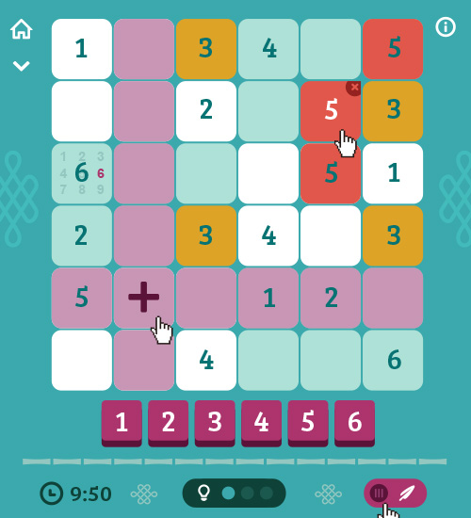
Sudoku Zen
Interaction Specification
Note mode interactions
Interaction:
User clicks the Note toggle to add a note to a cell. Note mode is ON
[audio: switch5]
Result:
-Numbers turn purple to indicate you are in note mode
Interaction:
User hovers over the board to place a number
Result:
-board highlights horizontal and vertical cells (purple) with a plus icon over place to add number
Interaction:
User adds a note
[audio: click3]
Result:
-Note gets added in small text in gridded location in cell

Slide 6
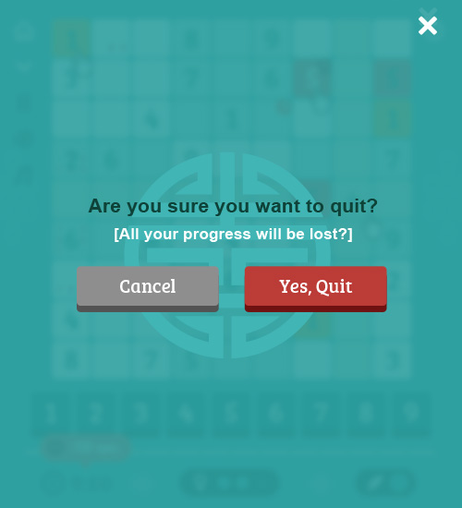
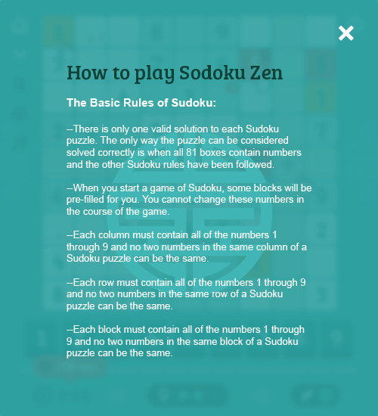
Sudoku Zen
Interaction Specification
Info and quit screen pop overs
Interaction:
User clicks info icon or Home icon
[audio: click3]
[audio: short_whoosh(1-3)]
Result:
-Pop up overlay [fades in]
-Symbol [fades in]
-Text and buttons fade [fades in]
Interaction:
User clicks the “x” close button or cancel button
[audio: click3]
[audio: short_whoosh(1-3)]
Result:
-pop over overlay [fades out]

Slide 7
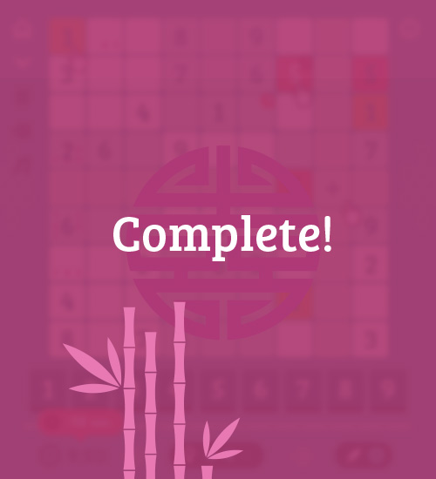
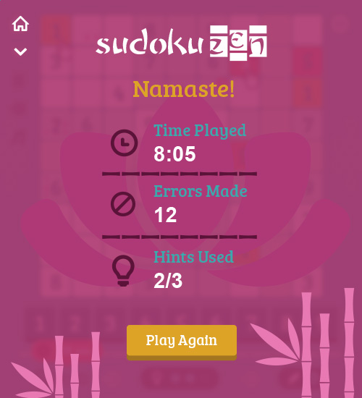
Sudoku Zen
Interaction Specification
Complete screen
Interaction:
User completes the puzzle
Result:
-Complete overlay shows first.
[audio: oriental_level complete_ding]
[audio: short_whoosh(1-3)]
1.BG [fades in]
2. Symbol [fades in] and [spins[
3. Bamboo [slides up]
4. “Complete” [fades in]
(stays for 3 secs)
5. Elements above overlay [fades out]
Summary screen
Sudoku logo fades in.
“Namaste!” [fades in] [audio: pop_drip]
Time Played [fades in] [audio: pop_drip]
Errors Made [fades in] [audio: pop_drip]
Hints Used [fades in] [audio: pop_drip]
Play again button [fades in] [audio: pop_drip]
Interaction:
User Clicks “play again”
Result:
-Screen [fades out] and Start screen shows
[audio: short_whoosh(1-3)]

